Slide 1
Paper Reading
Lv Chao

Slide 2
Paper List
Grammar as a Foreign Language
Are You Talking to a Machine? Dataset and Methods for Multilingual Image Question Answering
End-To-End Memory Networks
Ask Me Anything: Dynamic Memory Networks for Neural Language Processing

Slide 3
Grammar as a Foreign Language NIPS2015
Work from Hinton @ Google
Main Reference:
Learning Phrase Representations using RNN Encoder-Decoder for Statistical Machine Translation (seq-to-seq using GRU)
Sequence to Sequence Learning with Neural Networks (seq-to-seq using LSTM)
Neural Machine Translation by jointly Learning to Align and Translate (attention mechanism)

Slide 4
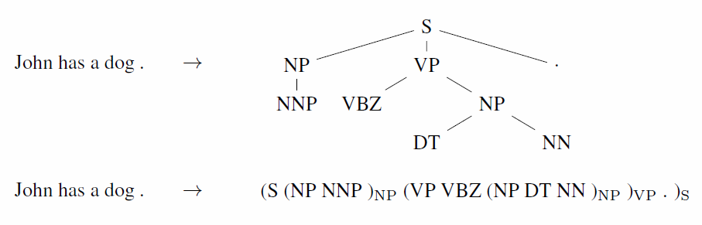
Task
Syntactic constituency parsing
DFS

Slide 5
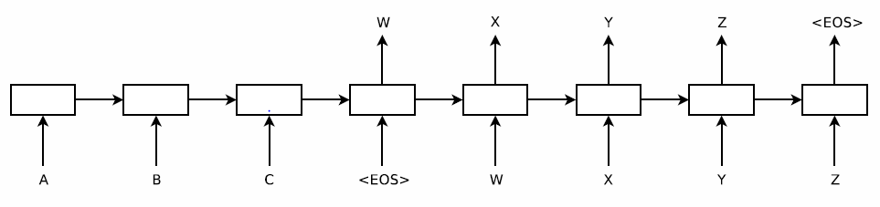
Seq-to-Seq Problem
One LSTM reads the input sequence, and generates a fixed vector
Another LSTM extract the output sequence from that vector

Slide 6
Three Tips about Seq-to-Seq
Two different LSTM
Deep LSTM
Read input sequence in reverse

Slide 7
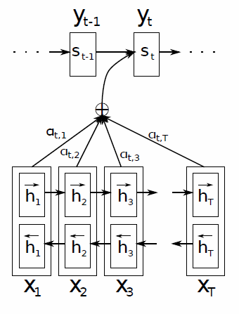
Attention Mechanism
BRNN

Slide 8
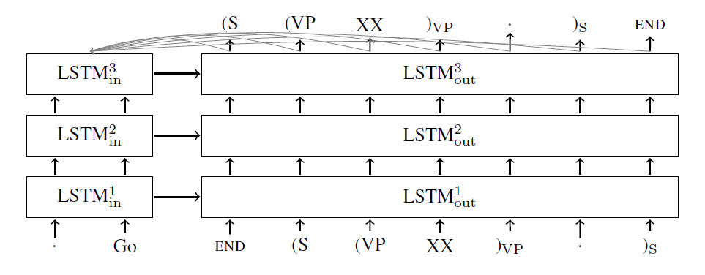
Model detail

Slide 9

Are You Talking to a Machine? Dataset and Methods for Multilingual Image Question Answering NIPS2015
Work from IDL @ Baidu
Main Reference:
Deep Captioning with multimodal recurrent neural networks(m-RNN)

Slide 10
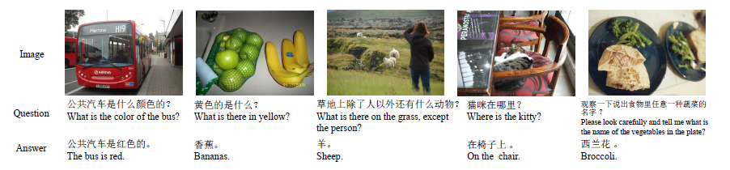
Task
Answer a multilingual questions about a image

Slide 11
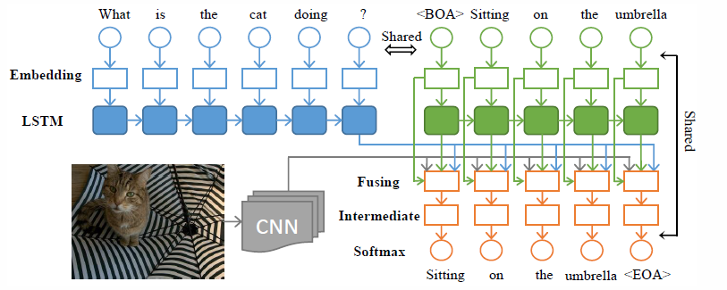
Framework
Fixed

Slide 12
The Weight Sharing Strategy
Weight matrix between the word-embedding layers of the first component and the third component
Weight matrix between the word-embedding layers of the third component and the softmax layer in a transposed manner

Slide 13
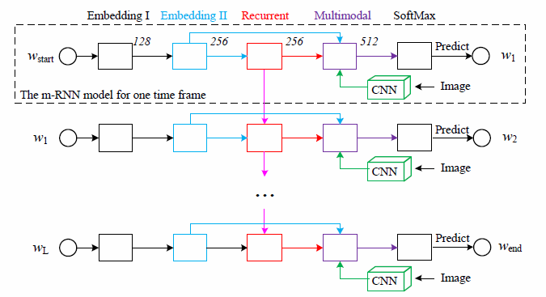
M-RNN (generate a description for a image)

Slide 14
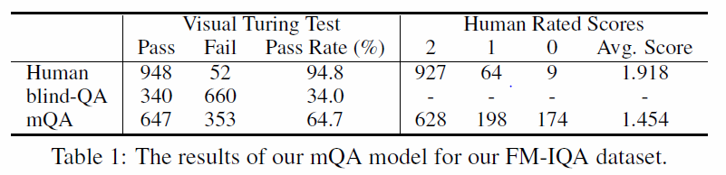
Turing Test & Rated Score

Slide 15
End-To-End Memory Networks NIPS2015
Work from AI Research @ Facebook
Main Reference:
Memory Network (also their work)

Slide 16
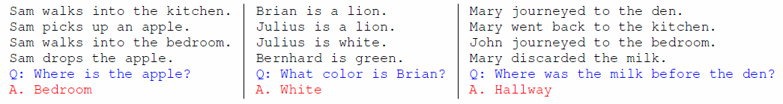
Task
Answer a simple question based on a list of statements.

Slide 17
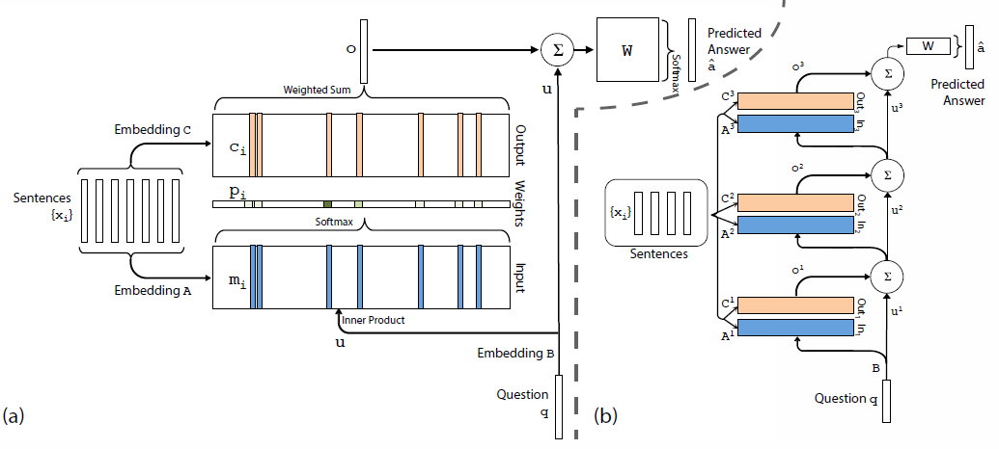
Framework
output
input
input

Slide 18
Framework
attention

Slide 19
Framework
attention

Slide 20
Framework
generation

Slide 21
Framework
Multi-hops

Slide 22
Two types of weight tying
Adjacent
A(k+1) = C(k)
W(T) = C(K)
B = A(1)
Layer-wise(RNN-like)
A(1) = A(2) = … = A(K)
B(1) = B(2) = … = B(K)
U(k+1) = H*U(k) + o(k)

Slide 23
Some Training Tips
Bow = bag-of-words representation
PE = position encoding representation
LS = linear start training
RN = random injection of time noise
Joint = joint training on all tasks (as opposed to per-task training)

Slide 24
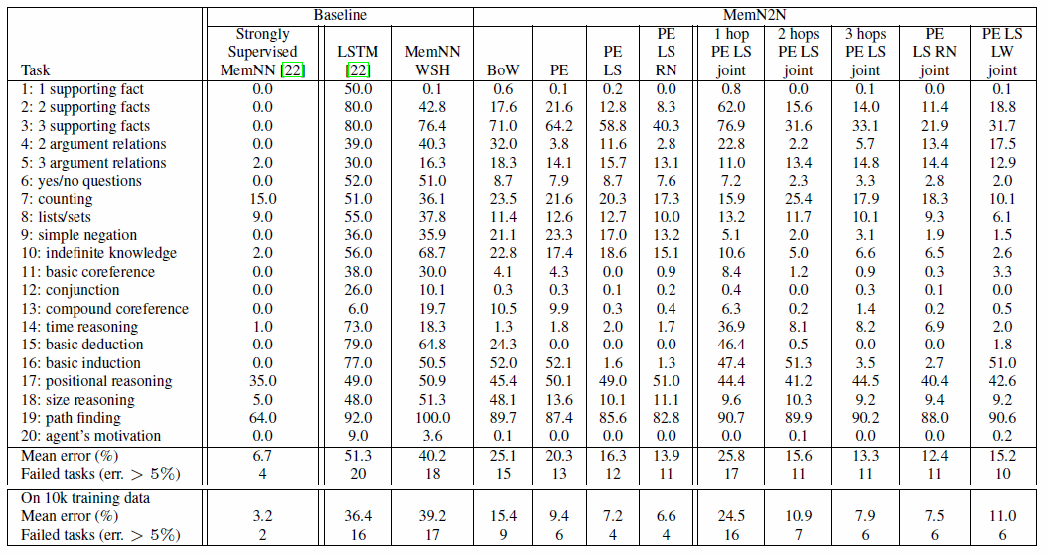
Result on Facebook bAbI

Slide 25



Example
Counting
Positional reasoning
Path finding

Slide 26
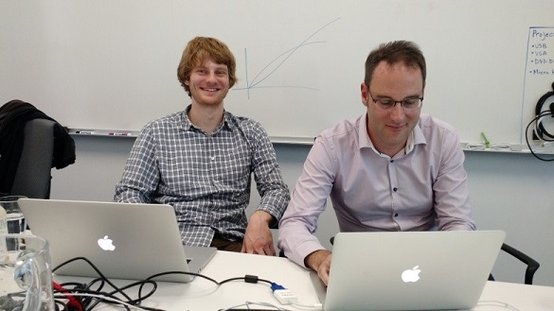
Ask Me Anything: Dynamic Memory Networks for Neural Language Processing
Work from Richard Socher @ MetaMind
Main Reference:
Memory Network

Slide 27
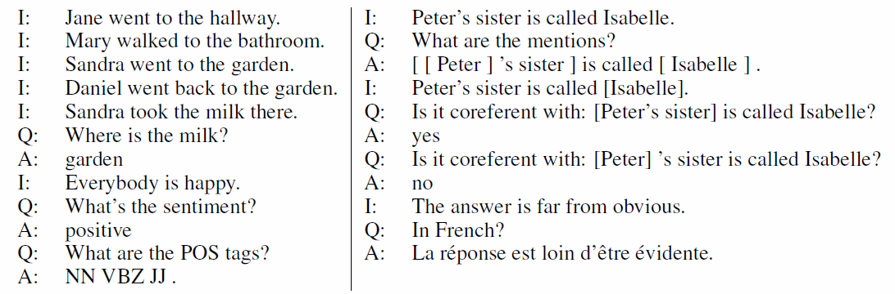
Task
Answer any NLP question based on a list of statements.

Slide 28
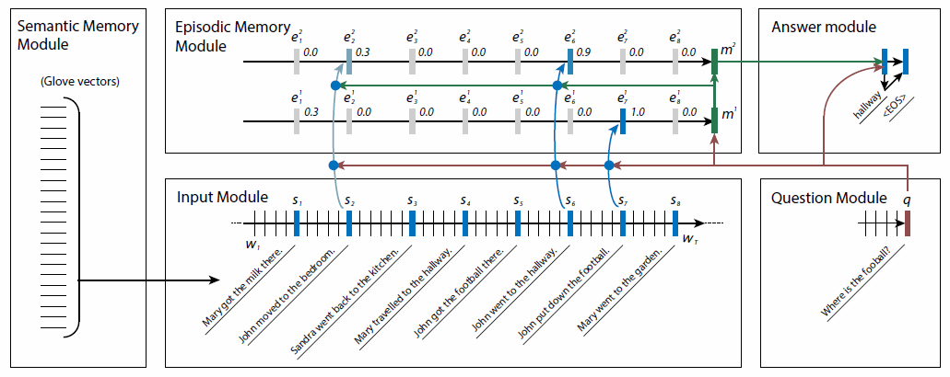
Framework

Slide 29
Framework
GRU

Slide 30
Framework
GRU

Slide 31
Framework
k passes:
one pass one m
Notes:
引入情景记忆，即对于一个问题，会扫描k次所有的facts，一次扫描产生一个情景记忆

Slide 32
Framework
gate
Notes:
扫描时，使用GRU进行扫描（相当于一个序列），对每一个facts计算一个gate值（attention），并用这个gate值辅助更新GRU的隐状态向量，使用最终的隐向量作为这次扫描获取的信息

Slide 33
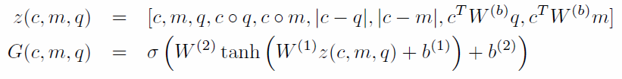
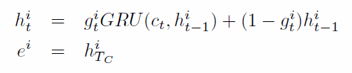

Detailed function
gate
one pass info
update

Slide 34
Framework
answer
Notes:
Answer模块就是在用一个GRU来decode之前生成的memory向量即可

Slide 35
Detailed function
init
output
update

Slide 36
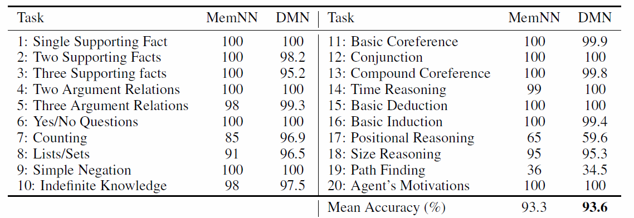
Result on Facebook bAbI

Slide 37
Thanks

